Slide 1
Web Controlled Camera Arm
Embedded Linux Project
Group_3

Slide 2
Group_3 Project: Camera Boom
Mitchell Wagner
Paul Boston
Jose Da Costa Filho
Charles Palsa
Shamiul Islam
Computer Engineer
Computer Engineer
Computer Science
Computer Science
Computer Science Minor

Slide 3
Elements of Project:
Desire
Website: Mobility, Buttons, Gallery, Video
Camera: Live Stream, Take Snap Shots
Stand: Strong, 3D printed Material
Motor: 360 degrees Motion any direction

Slide 4

Website

Slide 5
Website:
Functions:
Good user interface
Interactive buttons (motors, camera)
Mobile friendly
Be able to view past pictures (gallery)

Slide 6
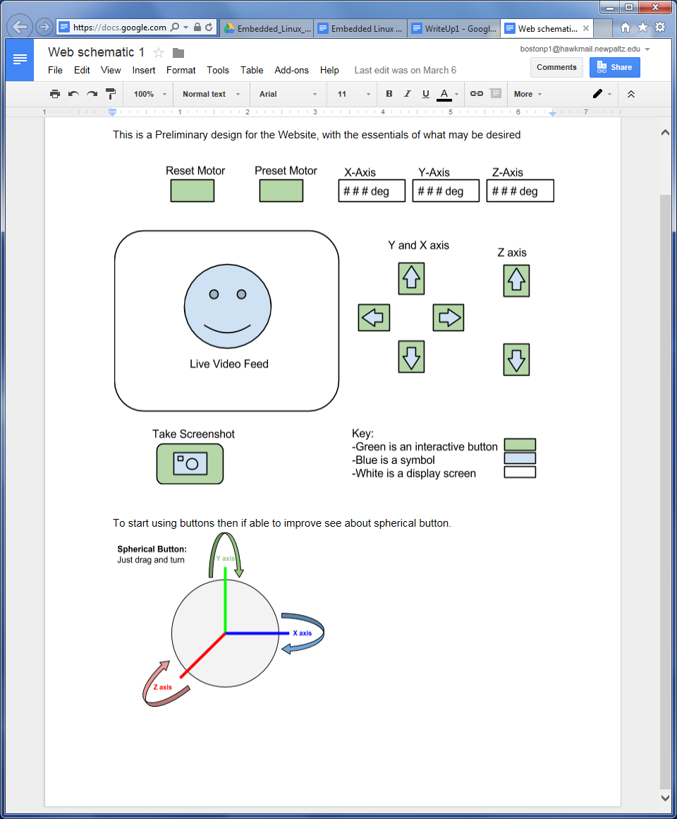
Preliminary Design Layout for Website

Slide 7
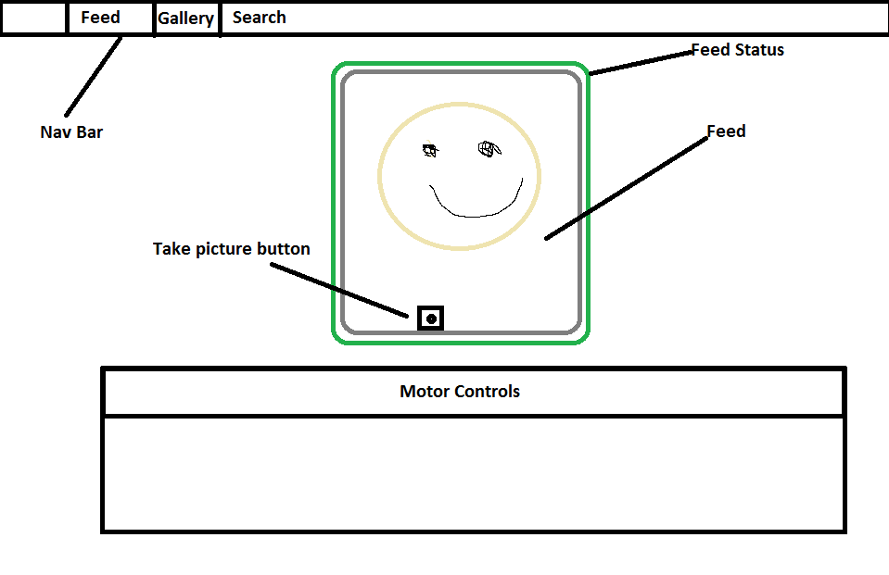
Current Website Layout

Slide 8
Website Problems
Functional/Intuitive UI
Asynchronous controls
Pi as a multiserver

Slide 9
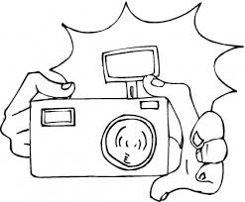
Camera

Slide 10
Camera:
Functions:
Live Feed
Take pictures/snapshots
Be able to be uploaded to the web

Slide 11
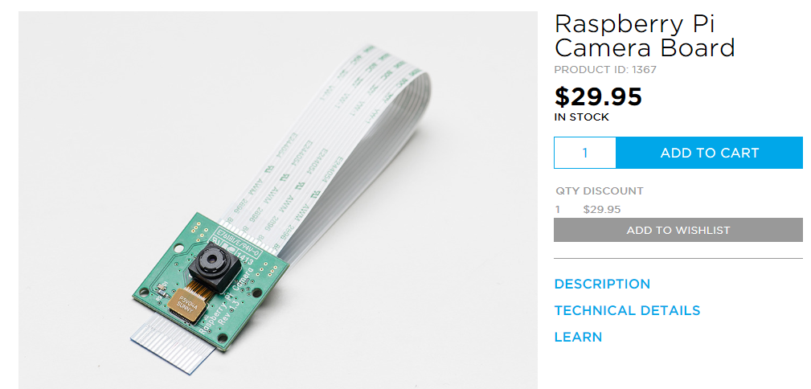
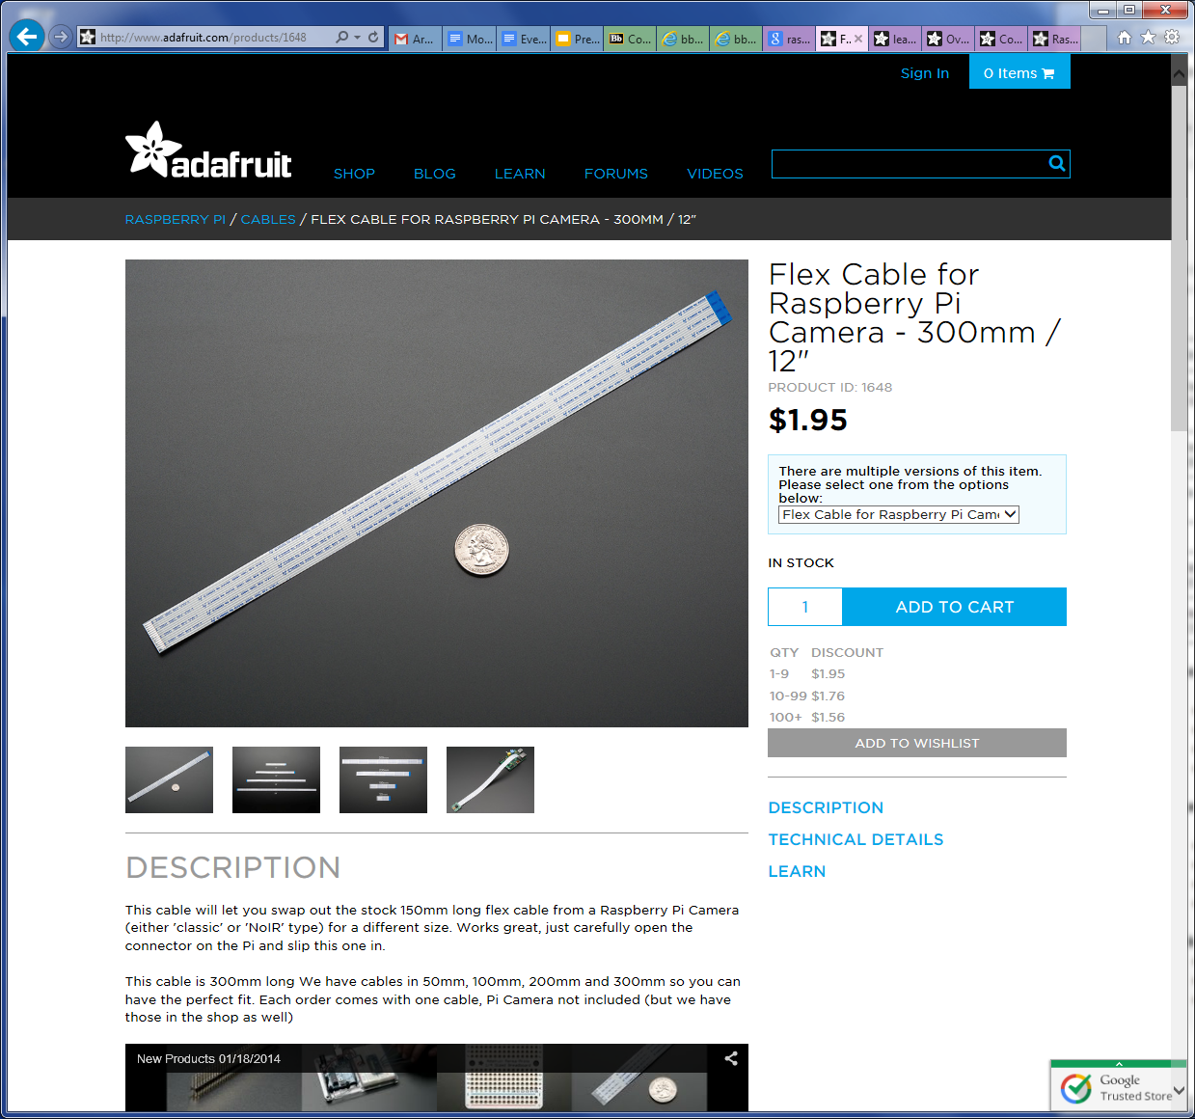
Camera Material
Raspberry Pi camera
Extension Cable

Slide 12
Camera Problems
Getting live stream to work through website
The slow speed in which it operates
Being able to take pictures

Slide 13
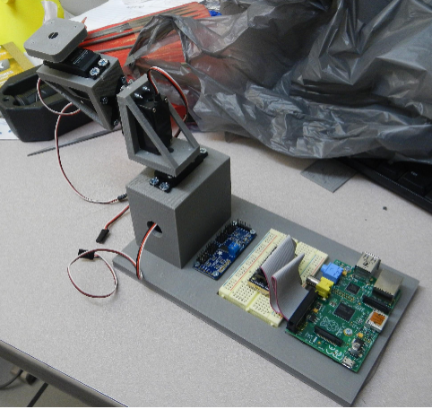
Stand

Slide 14
Stand:
Functions:
Needs to be able to allow for free movement
Strong and durable
Professional look
3D printing materials
Strong helps to keep everything contained

Slide 15
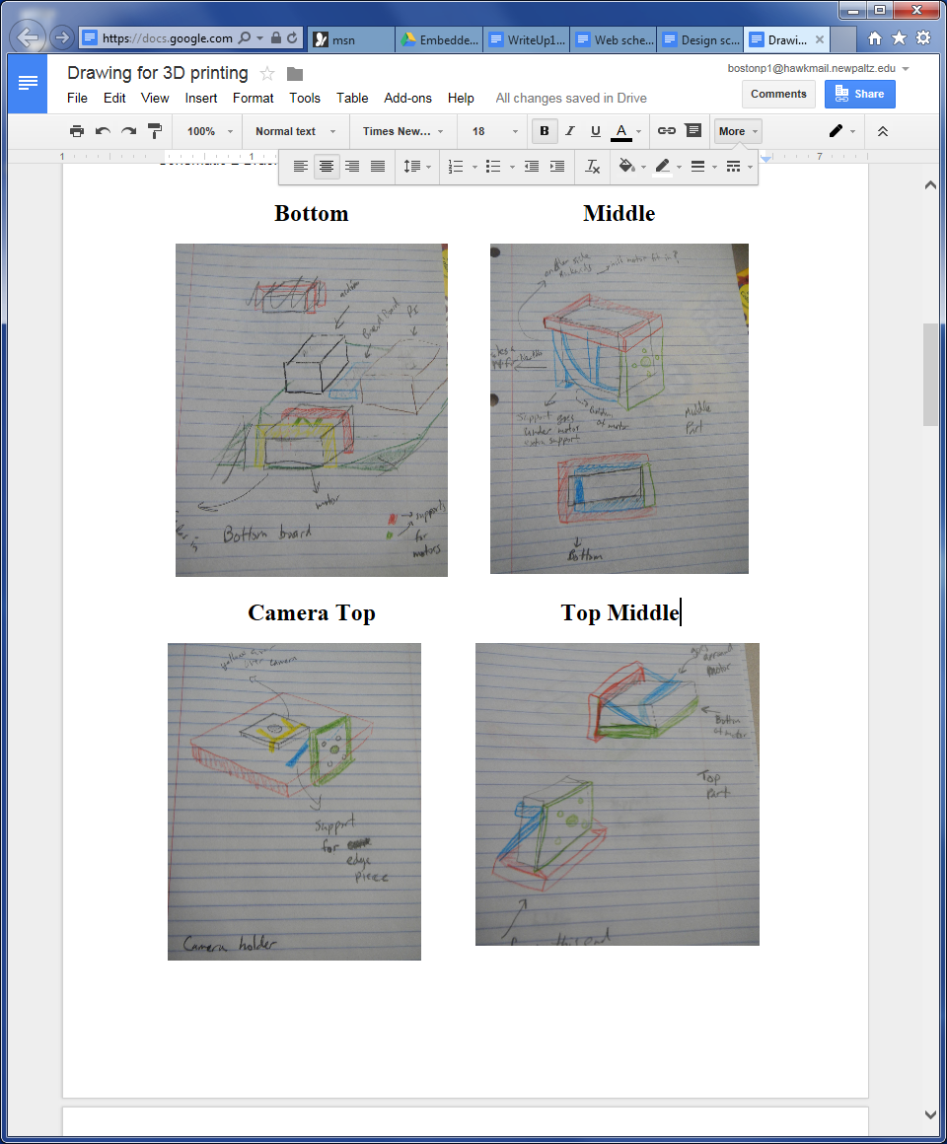
Drawing For Stand

Slide 16
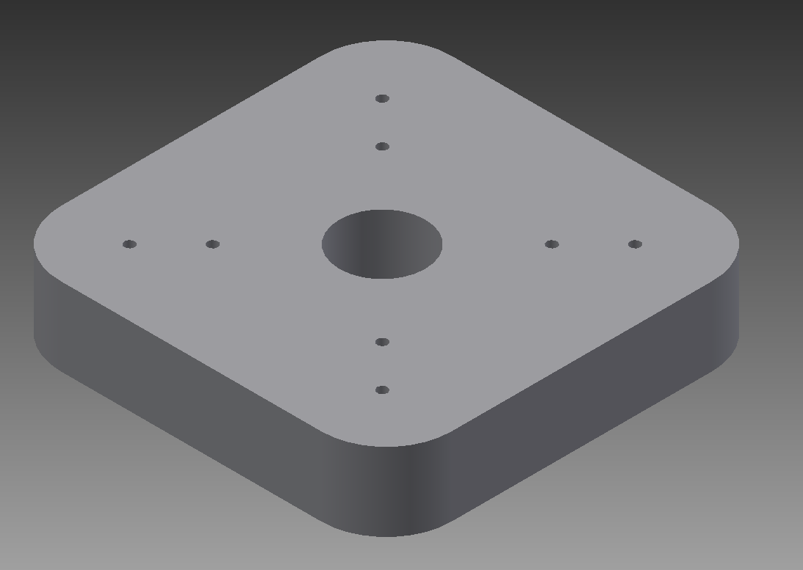
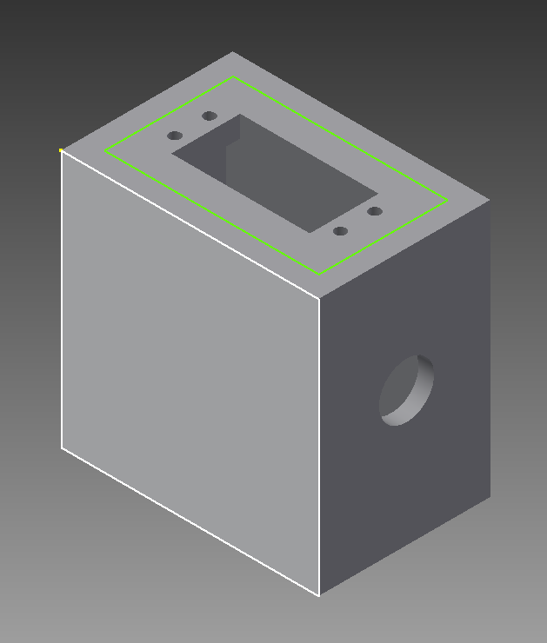
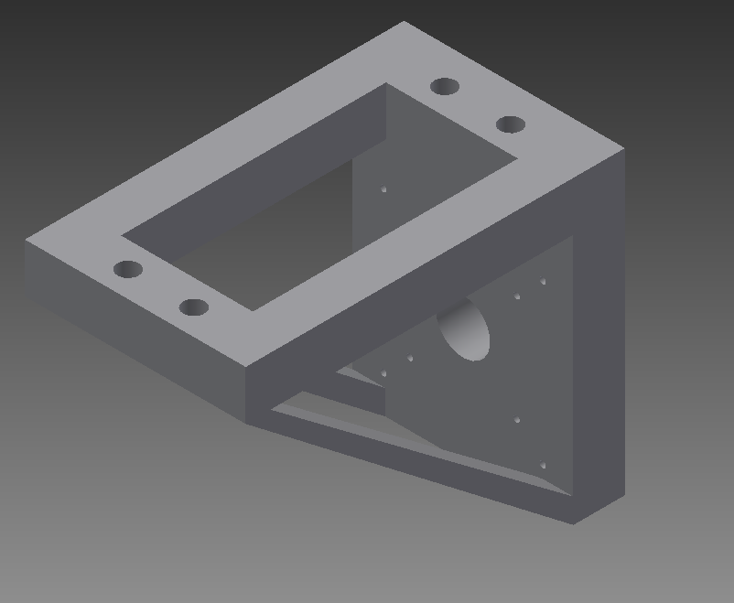
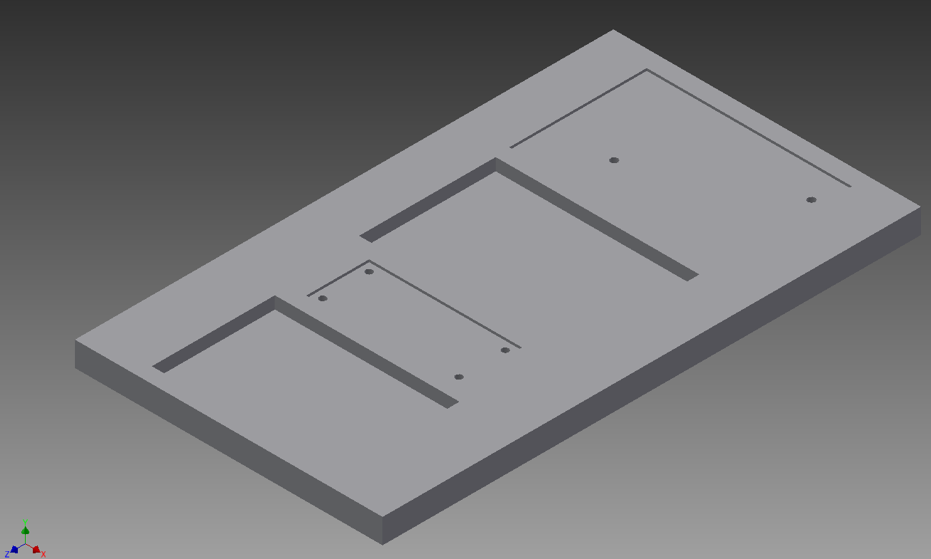
3D virtual Model Before
Printing
Camera Top
Bottom
Middle
Base

Slide 17
Stand after 3D Printing

Slide 18
Stand Problems
Designer input to not use boxes
Brackets instead of boxes
Getting holes to line up
Everything printed properly the first time

Slide 19
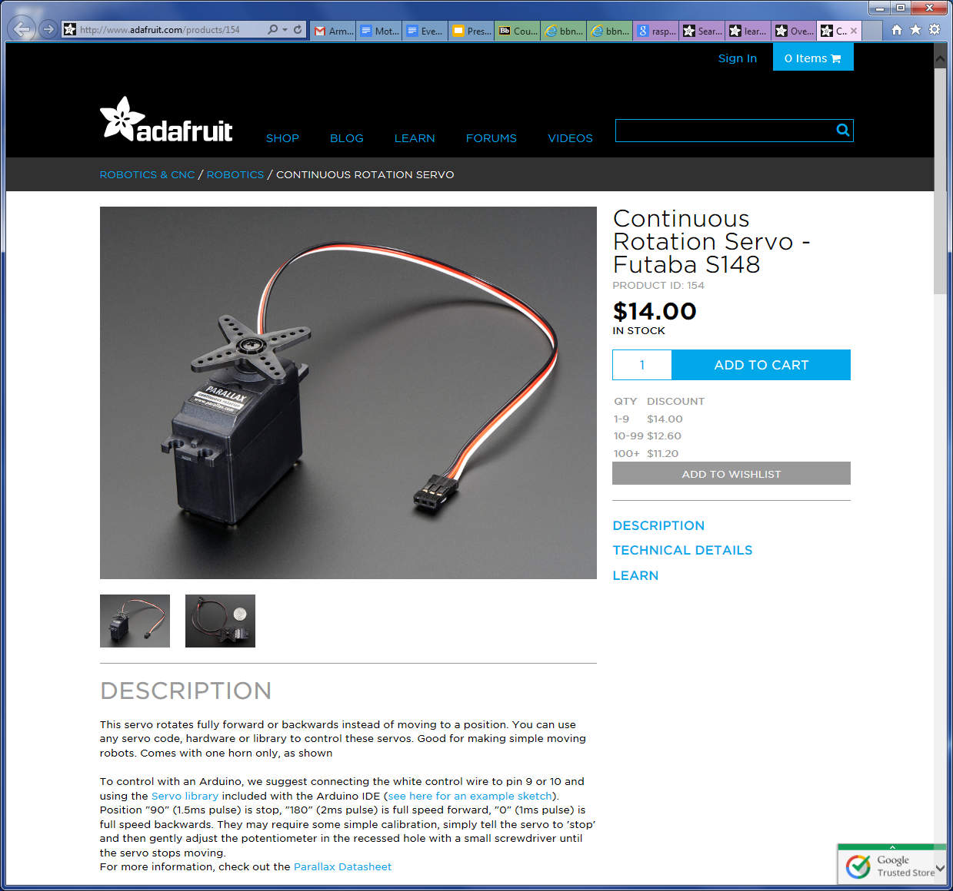
Motors

Slide 20
Motor:
Functions:
Control between -360 to 360 degrees
3 different motors to control each degrees location
Store where you are currently located
Have value save to not move

Slide 21
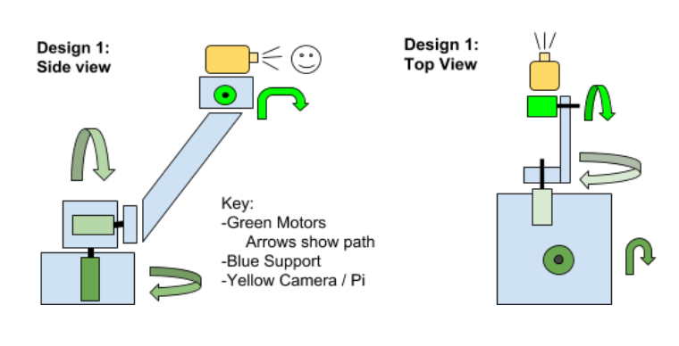
Motor Movements Directions

Slide 22
Motor Materials
3 continuous rotation motors 5V

Slide 23
Motor Problems
The motors movement “how it is done”
moving only a degree at a time
Restricting the degrees to move

Slide 24
The End

